Slide 1
Sales Dashboard Analysis Interactive Power BI Dashboard Presented By Konathala Mounika Date: 25-09-2025

Slide 2
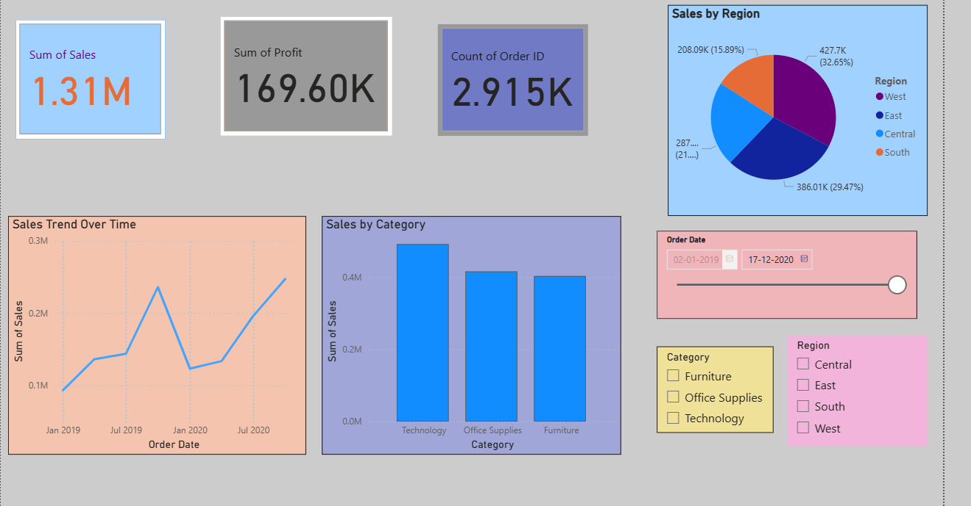
Interactive Sales Dashboard
Comprehensive view of sales performance from 2015-2019

Slide 3
Key Business Insights
Technology category generates highest sales ($0.5M+)
East region leads in sales performance (29.47%)
Steady growth trend visible over the time period
Total profit margin approximately 13% ($169K profit on $1.31M sales)

Slide 4
Key Performance Indicators
Total Sales: $1.31M
Total Profit: $169.60K
Total Orders: 2,915K
Regional breakdown across 4 regions
Category performance analysis

Slide 5
Technical Implementation
Tool: Microsoft Power BI Desktop
Data Source: Kaggle Superstore Dataset
Interactive Features: Date, Category, and Region slicers
Visualizations: KPI cards, line chart, bar chart, pie chart

